Slide 1
ADT372S ASSIGNMENT 2
By
Chuma Nxazonke (Team leader): 219181187
Ishmail Mgwena: 215088417
Thabiso Matsaba: 220296006
Athini Mbiko: 213196379
Group name: Avengers

Slide 2
PURPOSE
A diner will be able to book a table at the comfort of their home using the restaurant app that a diner can download on their phone through Google store for Android, App Store for iPhone or Huawei AppGallery. The Restaurant App is optional to a diner, diner can only book for table if they download the Restaurant App. When the host greets diners, the host first has confirm if the diner book online successfully on the system or if the diner didn’t book online at all, then the host will have to check on the system if they are any available tables for that particular diner, after that, the wait staff has to enter the diner’s order on the tablet.
The kitchen staff will view the order on their monitor. Once they are done preparing the order, the kitchen staff will have to notify the wait staff via the system by clicking on the monitor where they will be a section to confirm if the order is done. Wait staff will receive the notification on their tablet that the order is ready for the diner. The bus boys will be able to view the real-time floor status on their tablets if the table is clean, dirty or occupied. All the restaurant information will be saved and organized in database for management view and keep as reference.

Slide 3
SCOPE
If the diner wants to book a table online, then the diner will have to register on the system. After the diner have successfully register, then the diner will login with his/her credentials to check the availability of tables. The system will also allow the diner to check the dates and time before making a booking. If there any dates and time available, then diner will book online for table. System will receive the online booking from the diner. Then the host will a notification from the system.
System will also allow the host to check available tables if the diner didn’t book online. The system will allow the wait staff to place an order and send the order to the kitchen staff. Then, the system will manage the placed order and send a notification to the wait staff when the order is ready. The system will calculate total items ordered and price. The system will save the information to the database. The system won’t allow you to login without valid credentials.

Slide 4
stakeholders
Customer: the customer can book online.
Wait staff: the wait staff place an order.
The host: the availability of tables
Management of restaurant: can view the information and make decision based on that data.
Investors (include banks loaned from): the investors will fund the project.
Kitchen staff: the kitchen staff will receive and view the order.
Bus boy: the bus boy will view the real-time floor status.

Slide 5
FEASIBILITY
The system would make a major contribution to the restaurant's overall objectives by making the ordering process far more efficient, providing up-to-date analysis on restaurant performance, and reducing time spent on paperwork to allow more time for restaurant improvement. The manager will be able to monitor the inventory, manage their staff and track their cash flow. The system will also help the management by providing useful information to the management, so that they can make tactical decision for the restaurant.
By creating a remote system that allows customers(diner) to book a table online will help diners to avoid waiting long time for a table especially since we are still in COVID 19 restrictions. They will avoid being in contact with many people since they already have a table and practice social distancing by not waiting in a queue.
The completion date has not yet been determined, but based on the date for the component demonstration, this project should be completed on time. Furthermore, this project can undoubtedly be completed within the allocated budget. Both of these statements were created using only the technology that is currently available.

Slide 6
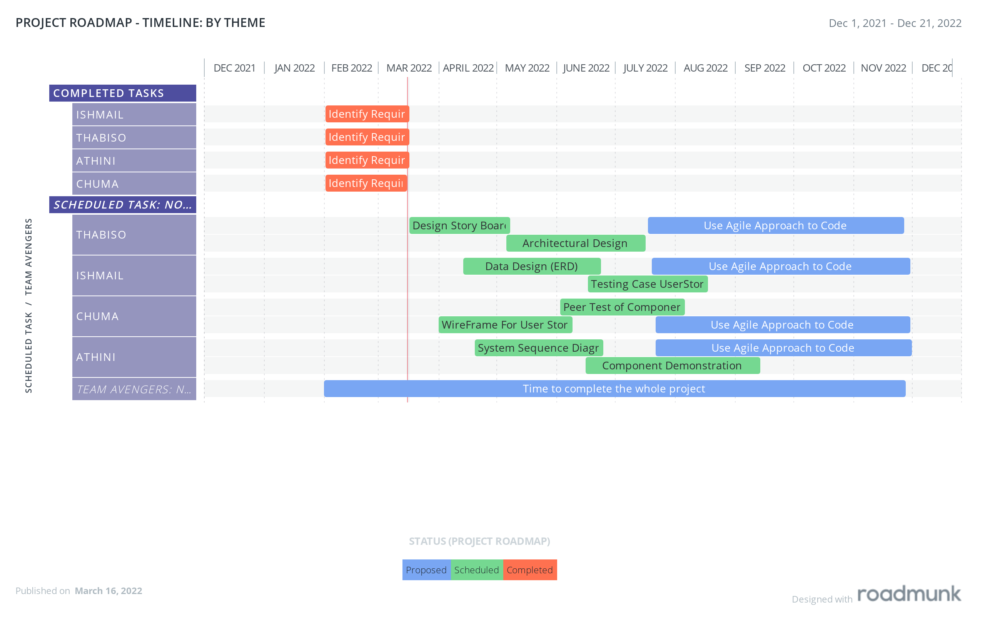
PROJECT ROADMAP

Slide 7
ETHICAL POLICY
Our team follows 5 principles of ethics:
We, as a team, will act in the best interests of our client and employer while keeping the public interest in mind.
As a team and as leaders, we will subscribe to and promote an ethical approach to software development and maintenance management.
Our team will make certain that their products and associated modifications meet the highest professional standards possible.
Our team will exercise professional judgment in the project with integrity and independence.
Our team will engage in lifelong learning about the practice of our profession and will promote an ethical approach to the profession's practice.
Additionally, I follow the ACM/IEEE-CS code of ethics and professional practice.

Slide 8
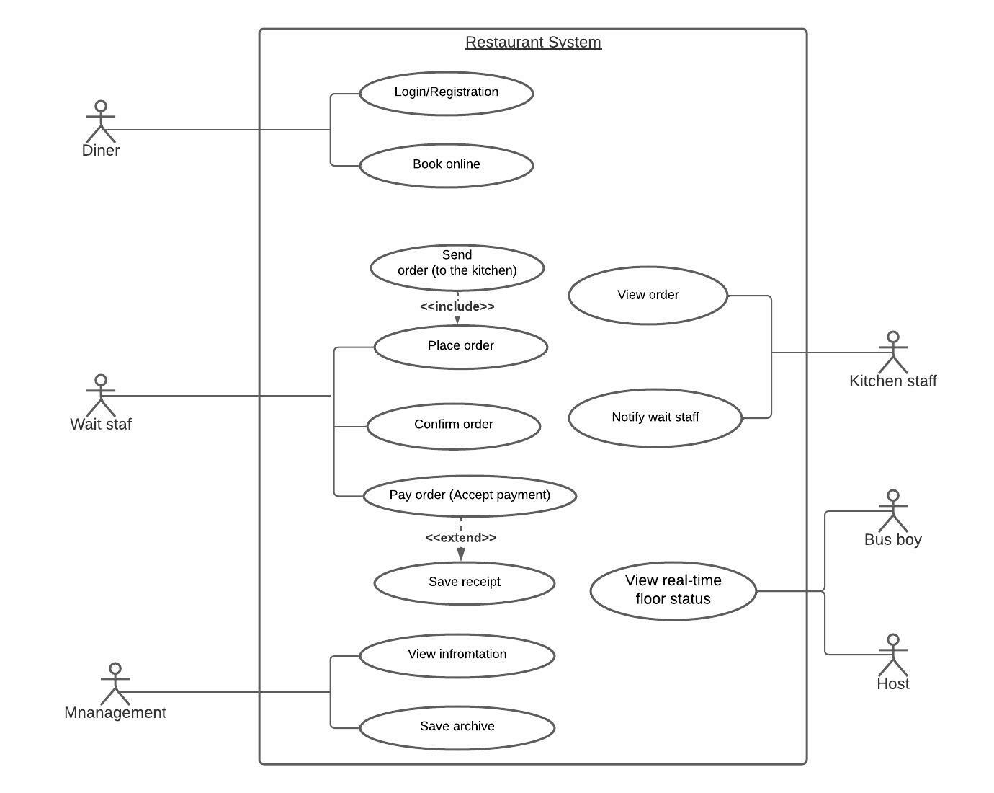
USE CASE DIAGRAM

